Slide 1
Multi-Factor Authentication (MFA/2FA) User Experience with Bypass Code

Slide 2
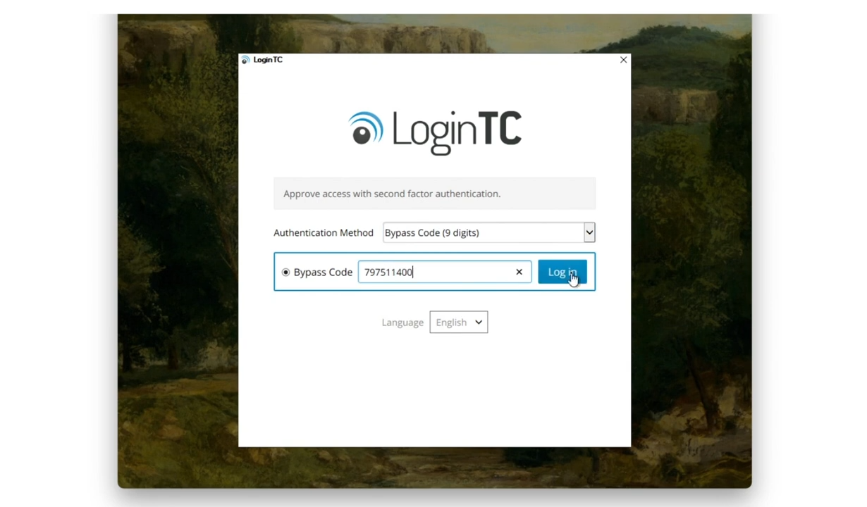
Bypass Code (Iframe mode)
Input first factor credentials
Select Bypass Code
Input 9-digit bypass code provided to you by your administrator into the available space.

Slide 3
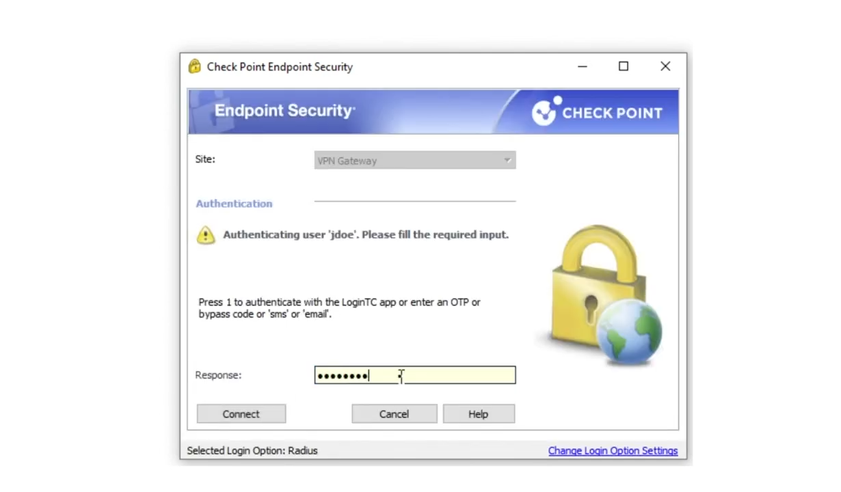
Bypass code (Direct mode)
Enter first factor credentials
Directly input 9-digit bypass code provided to you by your administrator into the available space.

